Slide 1

By Shailendra Kushwaha

Slide 2


User Experience (UX)
Encompasses all aspects of the end-user’s interaction with a particular product, system or service
Includes practical, experiential, affective, meaningful aspects of human-computer interaction
Includes user’s perception of system aspect of utility, ease of use and efficiency
Experts apply research and design methods to create products that people love
Critical winning factor for market lead
Rise of apple & Nokia's downfall
Exciting and growing field

Slide 3
User Experiences ????
The overall experiences of end users about that how the products seems
usability
Effectiveness
Efficiency
Accessible
Satisfaction
Less cost and more functionable with more usability
in a particular products.

Slide 4
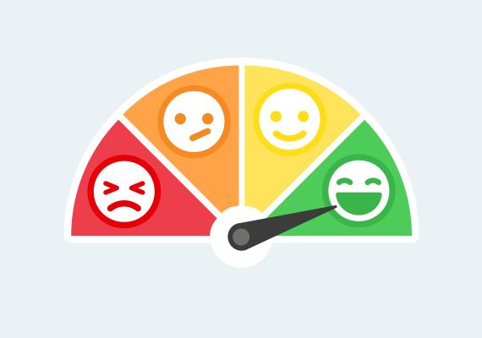
Bad Design vs Good Design 1.Bad Design
Information overload
Time consuming
Confusing

Slide 5
2. Good Design
Seems clear and eye catching information
Easily Scheduled
Not confusable

Slide 6
Signs of Good and Bad UX
An easy to understand navigation
Proper use of animation
Good color scheme
Clean layout
A visual appealing interface
Choosing a design that is appropriate to the topic or theme
Keeping designs elements and content organized
Unbelievable navigational structure
Poor typography makes it unreadable
Random use of colors
Not responsive design

Slide 7
What are the benefits of adding UX to a product Development Process??
Increased productivity
Increased sales and revenues
Decreased training and support costs
Reduced development time and costs
Reduced maintenance cost
Increased customer satisfaction
No Chances of product failure in Market

Slide 8

Consequent!!!
Good UX product have higher chances to success in market rather than Bad UX.
Goods design takes the investment but returns as more times.
Bad UX of curse reduced the life period of product in Market.

Slide 9




Initial official use of UX
“I invented the term because I thought human interface and usability were too narrow"
Don Norman
(former Vice President of the Advanced Technology Group at Apple)

Slide 10
Why UX is not?
Web design
Marketing
Customer satisfaction
Usability testing
Interaction design (IxD)
Information architecture (IA)
User interface (UI) design
User-centered design
Graphic design
Human factors engineering

Slide 11
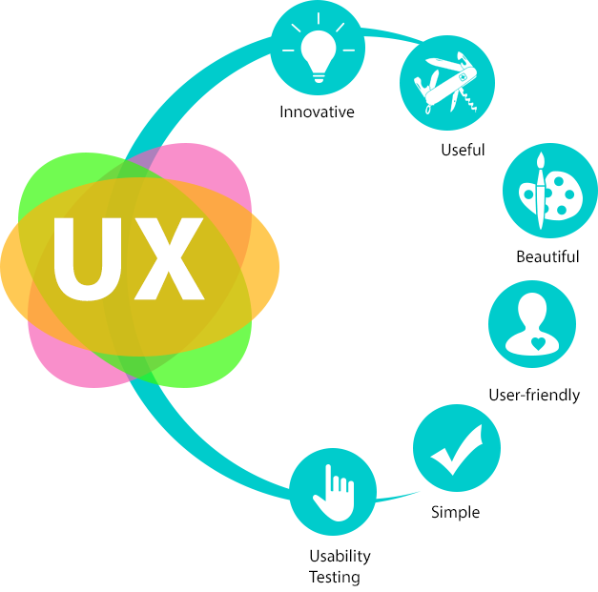
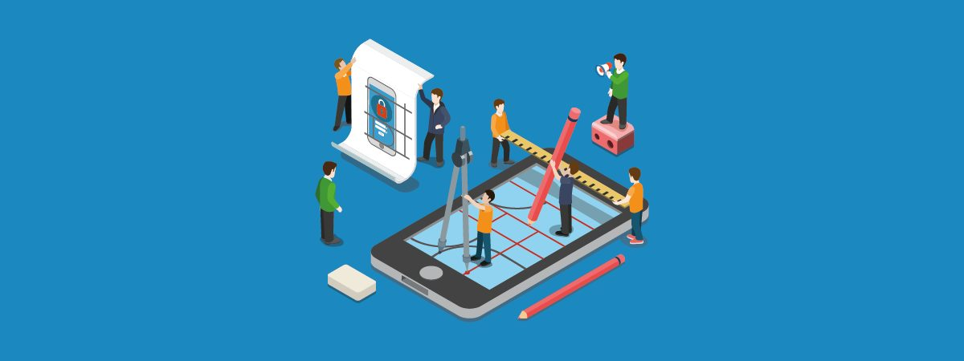
Factors affecting UX over time
1945 Bell Labs Hired psychologist to design telephone system
1950 UX work by Bell Labs to design touchtone keypad
1950s - 1983 UX profession grows from 10 people to around 1000
1980s start of PC revolution
1990s – 2000s Internet revolution & press coverage
1983 – 2017 from 1000 to 1 million UX professionals

Slide 12
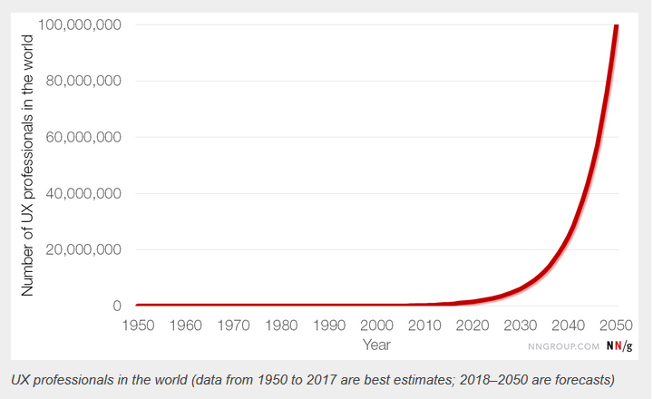
UX profession's growth

Slide 13
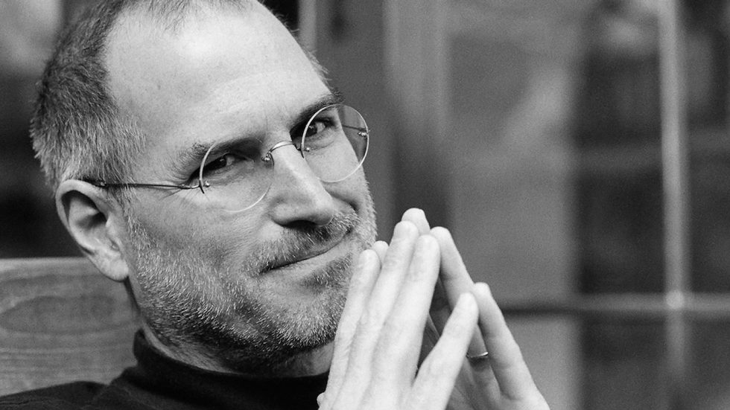
Why User Experience Matters?
”Design is not just what it looks like and feels like. Design is how it works.” – Steve Jobs.
User Experience design highlights and promotes product.
UX design as key part of building and growing customer confidence.
UX affect the ability of an organization to achieve its business goals even though product is technically great.
For the survival of product/ system in market

Slide 14
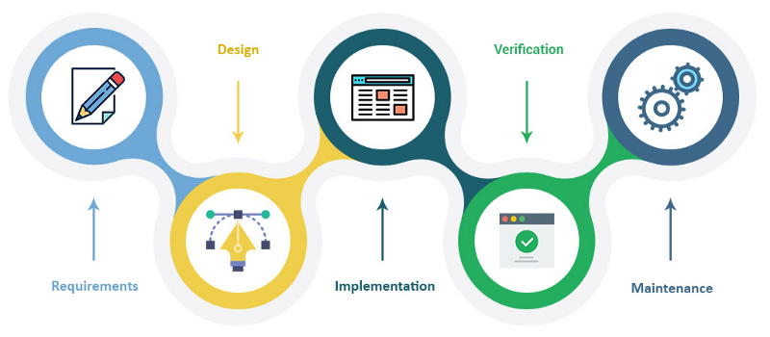
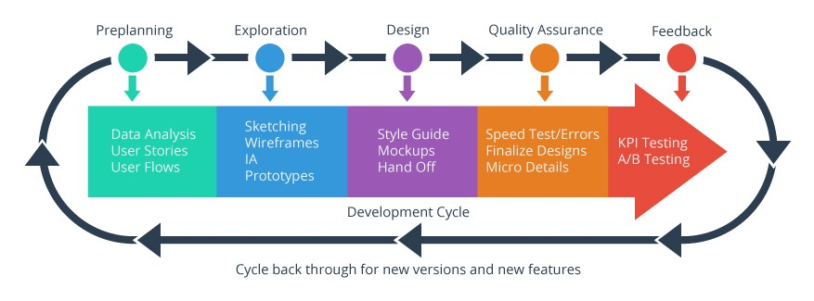
UX as process of product

Slide 15
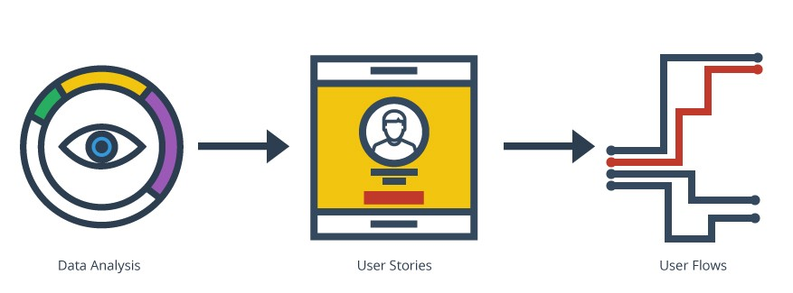
Step One: Preplanning

Slide 16
Data Analysis
” To be a great designer, you need to look a little deeper into how people think and act.” – Paul Boag
Data Analysis is key step to assure end-user’s need.
It includes:-
Analyze requirements to understand users needs in thier environment.
Heat mapping to learn about user habits in the design.
It’s great way to setup a controlled group and discover user habits, if user testing is in the budget.
Behaviour based surveys to get user’s opinions on the usability of the current system / required one.

Slide 17
User Stories
User stories leads to the creation of user personas.
User personas include characteristics such as:-
Age
Location
Language
Internet usage
Personal interest
Religious and cultural aspects

Slide 18
User Flows
First step in design process
User flows lead to red routes
Red routes are crtical tasks task that deliver most value to users
Capturing 90%+ user’s actions, it make product valuable

Slide 19
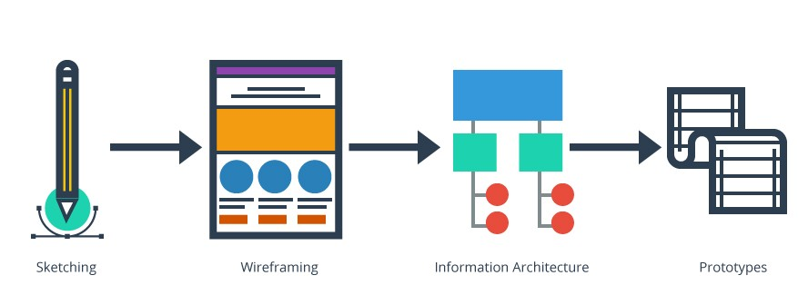
Step Two: Exploration

Slide 20
Step two: Exploration
It consists of sketching, wireframing, information architecture, and prototyping
Collected data at this point can be used to explore users interaction with product
Good point to start working with prototypes.
It consists of:
Identifying the layout
Developing Visual hierarchy
Deciding contents in each view and alot more

Slide 21
Sketching
It allows for the quick and easy exchange of ideas
At this point team can explore outlandish ideas
Best ways to arise innovative ideas
Involves UI definition of required feature in product

Slide 22
Wireframing
Acts acts as the blueprint for the design
Conncect Information Architecture (IA) to the visual design
Explains behaviours and flows of the product
Helpuful all related to project
For designers, explains UI for mockup process
For developers, explains functionality
For clients / stakeholders, provides reassurance

Slide 23
Information Architecture
Structural design of shared information environments
IA and wireframing go hand in hand
Deciding the layout of content, copy, images, and icons

Slide 24
Prototypes
Step to get product in motion
Allows to hide the complexity from client
Tools like Marvelapp, Axure, Invision

Slide 25
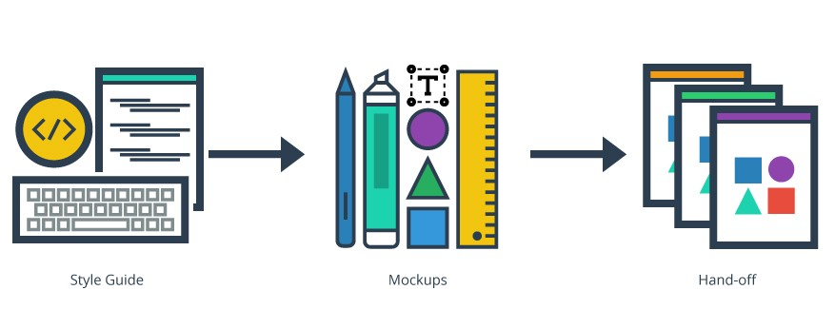
Step Three: Design

Slide 26
Step Three: Design
At this stage mockups start to take shape, colors and fonts can be chosen, branding and/ or brand guidelines can be introduced
Process can vary with the working teams
UX designers focusing on solely on design and handovering other things to developers
Either UX designers can hold the role UX developers as well by building coded UI elements

Slide 27
Style Guides
It can be simple sets of visual guidelines like a brand style guide
It can be in-depth acting as a front-end framework-like foundation or bootstrap with UI widgets, variables, and even page templates

Slide 28
Mockups
Use of mockups at this point is presentational
Becoming smaller due to wireframes and style guides becoming more detailed
Hepls demonstrating products to client, stakeholder, or potential investor
Animating mockups can help non technical people visually to understand product

Slide 29
Hand-off
Right point to hand over designed product to developer
It includes data URIs, SVGs, custom icon fonts and more
Stage at which poject is state to change in digitalized form
Designers and developers working together to build the app and intergrate UI with the backend architecture

Slide 30
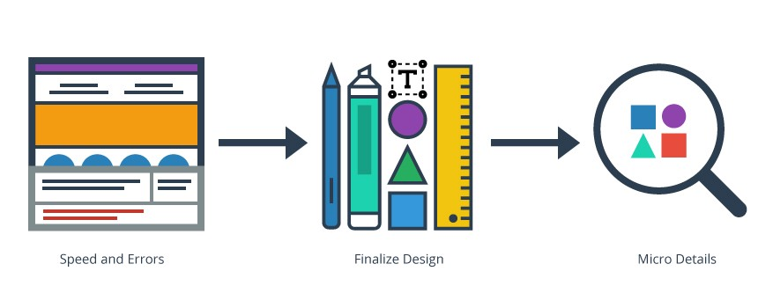
Step Four: Quality Assurance (Q/A)

Slide 31
Step Four: Quality Assurance
Occuring throughout every step of the product developement
Point to discover weak points in the design and user errors
Possible errors can be resolved before a beta release
Sureity of quality requirement fulfillment
Includes management of raw materials, products, services and components

Slide 32
Step Four: Quality Assurance
Speed and Errors: Testing every user flow to find erros, loads, performance; tools- Speed test, Selenium, AgileLoad, BrowserStack a lot more
Finalize Design: Includes conversion icons to icon fonts, cleaning up the presentation of visual elements to ensure font and identifying uncessary features
Micro Details: material design concept emerged from Google’s UX, app ready for its beta release, UX designer can collect user feedback to identify issues with speed and functionality

Slide 33
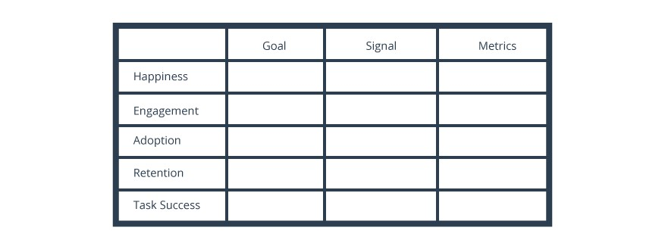
Step Five: Feedback

Slide 34
Step Five: Feedback
UX designer’s gets real feedback outside of controlled user testing
Critical steps to the product success
KPI to understand the impact of UX changes on end user
Basic traffic metrics to evaluate impact of UX changes

Slide 35
Conclusion
UX designer is making the overall experience of a person interaction with product
UX is important for business survival in market
UX ensures ”Preventation is better then cure!”
UX fulfills the emotional involvement of end-user’s

Slide 36


Questions?
How should the designer analyse designing?
How can you make your product more usable than competitors?

Slide 37
References
https://www.mockplus.com/blog/post/bad-web-design
http://uxdesign.com/ux-defined
https://www.nngroup.com/articles/100-years-ux/

